Slide 1
Linear Algebra
Linear algebra is foundational to data analytics because it provides the mathematical framework to represent and manipulate data efficiently..

Slide 2
What is Linear Algebra?
Linear Algebra is the branch of mathematics dealing with vectors, matrices, and their transformations.
Core to understanding algorithms in Machine Learning and Data Science.
Vectors: A single data point (like a customer’s features: age, income, etc.) can be represented as a vector.
Matrices: A dataset (rows = observations, columns = features) is naturally represented as a matrix.
Example: A dataset with 1000 customers and 5 features → 1000×5 matrix

Slide 3
Why Linear Algebra for DA/DS
It provides the mathematical frame work to understand, manipulate, and compute with data efficiently.
It is used for tabular data sets(row/column) to represent as matrix.
Where each row as data point and each column as feature.
Feature for individual data point are represented as vector in n-dimensional space.
To analyze correlation with in data using correlation covariance matrix.

Slide 4
Real-Life Analogy
Online Shopping: A product on an e-commerce site has multiple attributes: price, rating, number of reviews, brand, etc.
Each product can be represented as a vector: Product A=[Price: 1000,Rating: 4.5,Reviews: 300,Brand: 1]
Now, if they want to compare two products, they are essentially comparing vectors.
Customer Segmentation (Clustering in Business Analytics)
Customers are often grouped based on their purchase behavior, income, age, and preferences.
Each customer is a vector in a high-dimensional space.
Companies compare these vectors to segment customers and personalize marketing strategies.

Slide 5
Financial Analysis (Stock Market Trends)
A stock’s performance over different days can be seen as a vector.
Comparing two stocks is like comparing vectors to see if they move in a similar direction.
A dataset with columns Age, Income, Spending Score represents each customer as a vector (25, 50000, 80).
Netflix & Spotify Recommendations
When you watch a movie on Netflix or listen to songs on Spotify, the system suggests similar content.
How does it work? Each movie/song is a vector with attributes like genre, duration, director, ratings, etc.
Users are vectors too! Your watching/listening history is converted into a preference vector.
The recommendation system finds movies/songs with vectors closest to yours using similarity measures (like cosine similarity).

Slide 6
Credit Score & Loan Approval (Customer Profiles as Vectors)
Banks analyze past loan applicants and assign them a credit score based on:
Income
Debt-to-income ratio
Credit history
Number of loans
Late payments
Each customer is a vector of these financial attributes.
When a new applicant applies, the bank compares their vector with past approved/rejected applicants.

Slide 7
Marketing & Customer Targeting
Ever wondered why you see ads related to your recent searches?
Companies create a customer persona vector for you based on:
Age
Location
Browsing history
Purchase behavior
Social media activity
They then match your vector with others who have made similar purchases and show you ads accordingly.

Slide 8
Sports Analytics (Player Performance as Vectors)
In sports, players are evaluated based on:
Goals scored
Pass accuracy
Speed
Stamina
Defensive skills
A footballer with (15 goals, 90% pass accuracy, 30 tackles, 80 sprint speed) is a vector.
Coaches compare these player vectors to find the best fit for the team.

Slide 9
Why Are Vectors Important?
Every business and tech application today represents data as vectors.
Understanding vectors helps analyze, compare, and predict patterns in finance, marketing, sports, e-commerce, and social media.
Without vectors, there would be no Google Search, Netflix recommendations, credit scoring, or targeted ads!

Slide 10
Vector Math Helps in Decision-Making
Distance between vectors → Helps in finding similar customers, products, or trends.
Direction of vectors → Helps in understanding growth trends and movement in data.

Slide 11
Core Concepts
Scalars (0-Dimensional Tensors)
Vectors (1-Dimensional Tensors) and Matrices (2-Dimensional Tensors)
Matrix Operations
Norm(L1 andL2)
Cosine Similarity
Normalization
Eigen Vector and Eigen Value

Slide 12
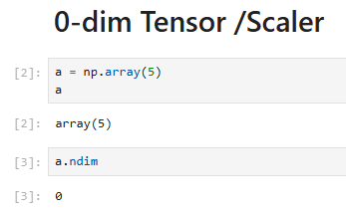
Scalars (0-Dimensional Tensors):
A scalar is a single number or a single value. It has zero dimensions (0-D tensor).
In data set scalar is essentially a single element.
Example: A single integer like 5 or a real number like 3.14.

Slide 13
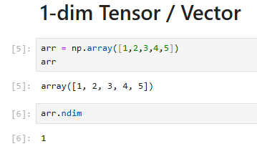
Vector (1-Dimensional Tensors):
A vector is a one-dimensional array of numbers.
It is essentially a list of numbers and has one dimension (1-D tensor).
In data set vector can be said as row vector for addressing a single row wrt all features .
A column vector addressing all data points wrt a particular feature.
Example: [2,4,6] is a vector with 3 elements.

Slide 14
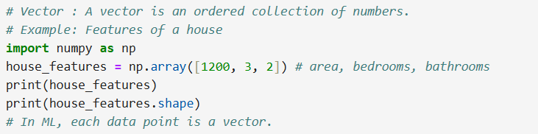
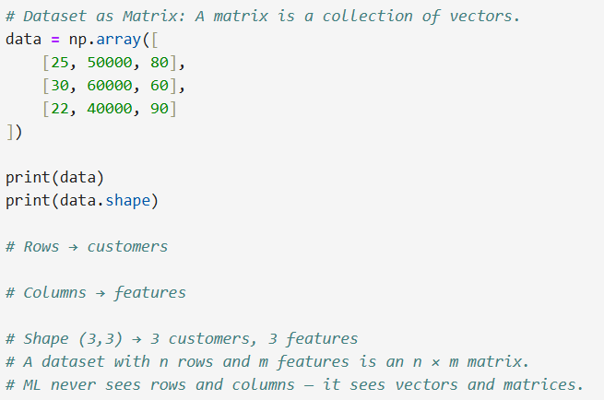

Slide 15
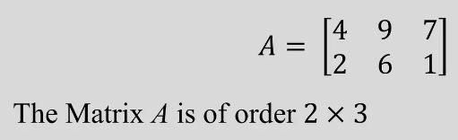
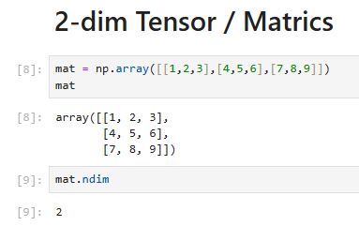
Matrix(2-Dimensional Tensors):
A matrix is a two-dimensional array of numbers.
It can be thought of as a table of numbers with rows and columns as DATAFRAME.

Slide 16
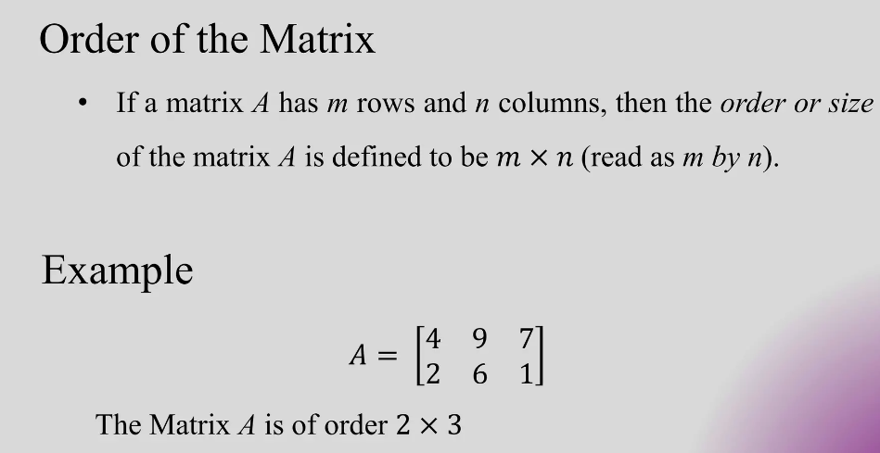
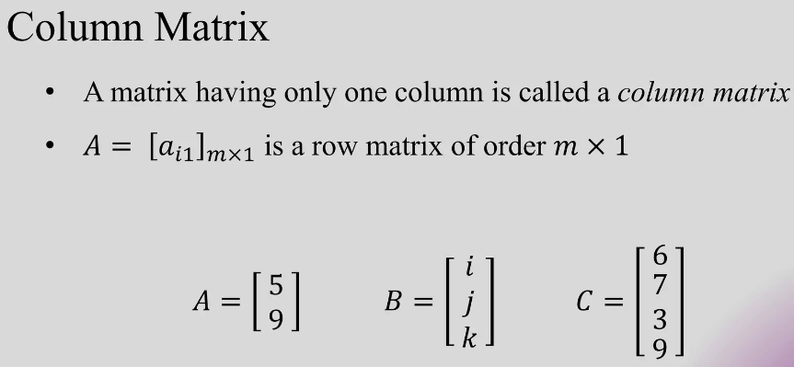
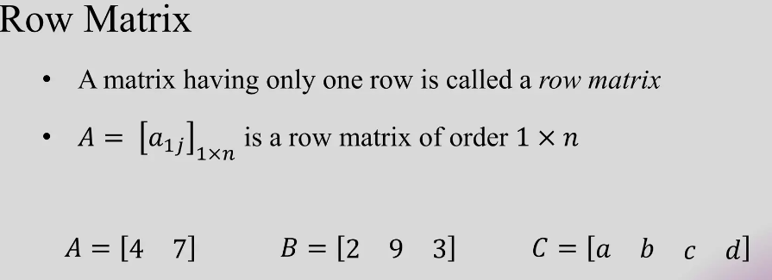

Slide 17
Matrix Operations
Scalar addition and subtraction
Matrix Addition and Subtraction
Matrix Multiplication
Dot Product
Matrix Transpose

Slide 18
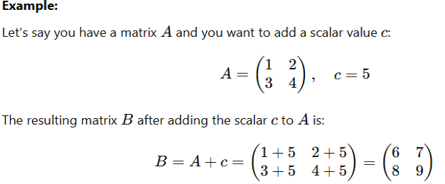
Scalar Addition
Scalar addition refer to the operation of adding a scalar (a single numerical value) to every element of a matrix or vector.

Slide 19
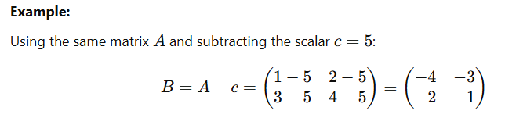
Scalar Subtraction
In scalar subtraction, the scalar value is subtracted from each element of the matrix or vector.
Example: Scalar subtraction is often used in mean centering, where the mean of a dataset (a scalar) is subtracted from each data point to center the data around zero.

Slide 20
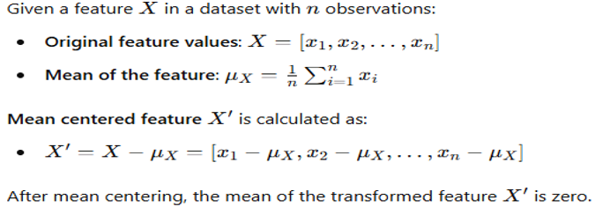
Mean Centering
Mean centering is a preprocessing technique used in data science to modify the features of a dataset by subtracting the mean of each feature from the data points.
This results in the transformed features having a mean of zero.

Slide 21
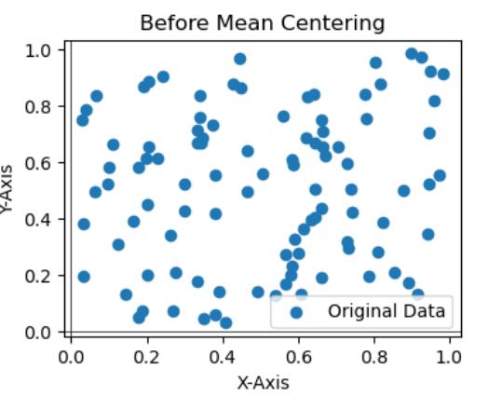
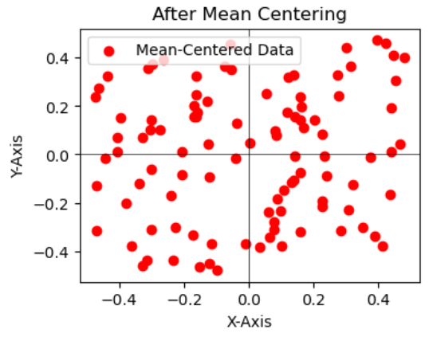
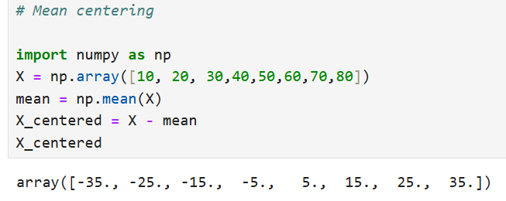

Slide 22
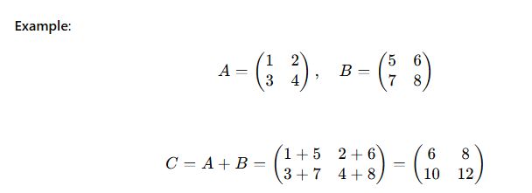
Matrix Addition
Definition: Given two matrices A and B of the same dimensions, their sum C is obtained by adding corresponding elements.
Cij = Aij + Bij

Slide 23
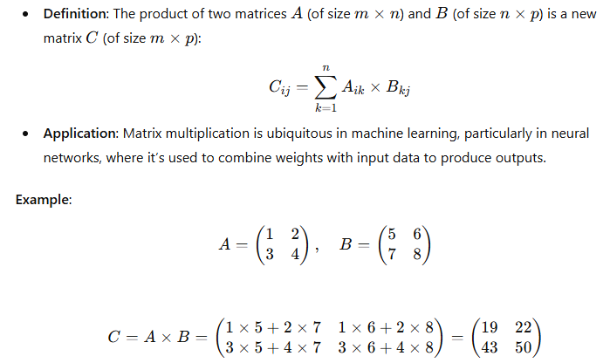
Matrix Multiplication:

Slide 24
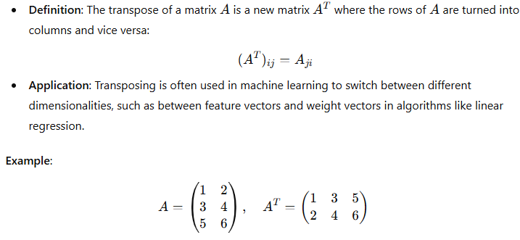
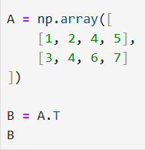
Matrix Transpose

Slide 25
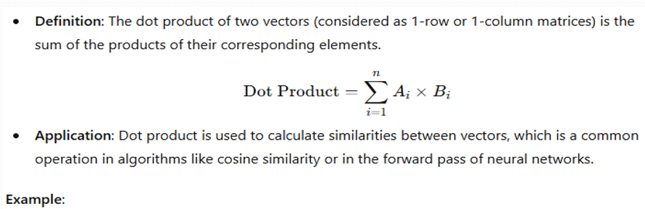
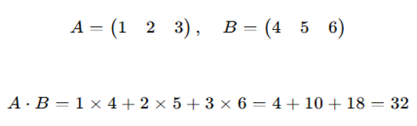
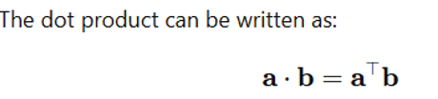
Dot Product

Slide 26
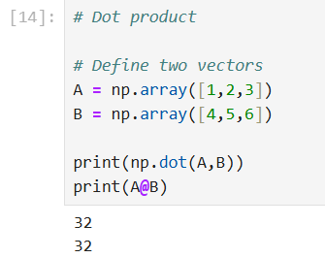
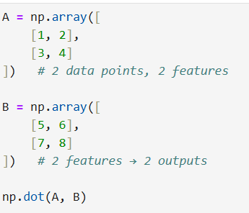

Slide 27
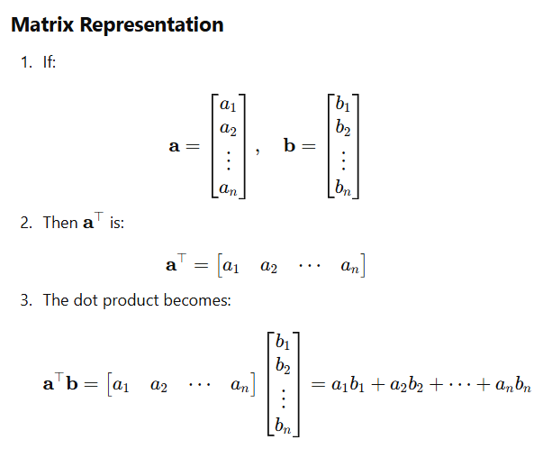

Slide 28
Norms(L1 and L2)
Norms are functions that measure the size or length of a vector in a vector space.
In data science, norms are often used to quantify the magnitude of vectors, such as weight vectors in machine learning models, or to measure the error or difference between predicted and actual values.
L1 Norm (Manhattan Distance)
L2 Norm (Euclidean Distance)

Slide 29
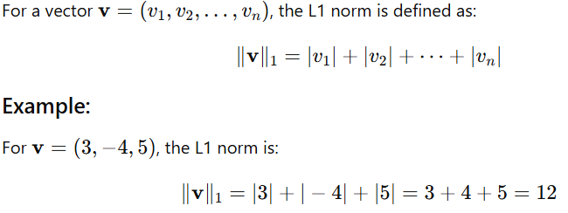
L1 Norm: (Manhattan Norm or Taxicab Norm)
The L1 norm of a vector is the sum of the absolute values of its components.
It is called the Manhattan norm because it mimics the way one would travel through the grid-like streets of Manhattan (following a path along the axes).

Slide 30
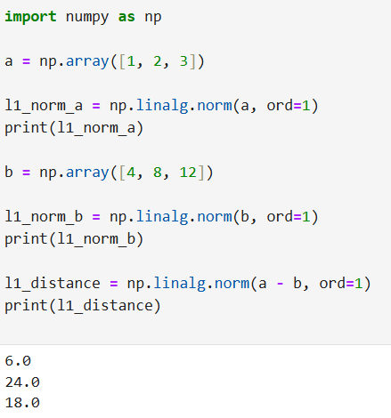

Slide 31
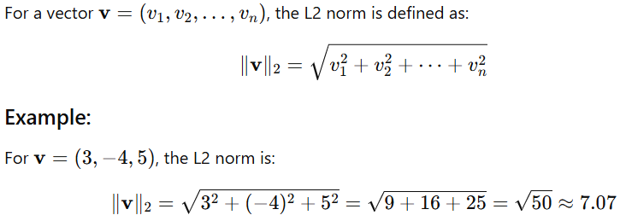
L2 Norm (Euclidean Norm)
The L2 norm of a vector is the square root of the sum of the squares of its components.
This is the most common measure of vector magnitude and corresponds to the Euclidean distance from the origin to the point represented by the vector.

Slide 32
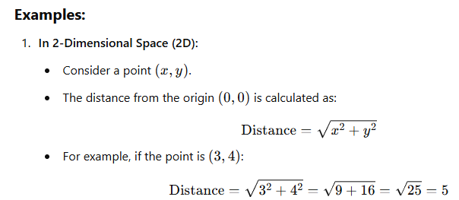
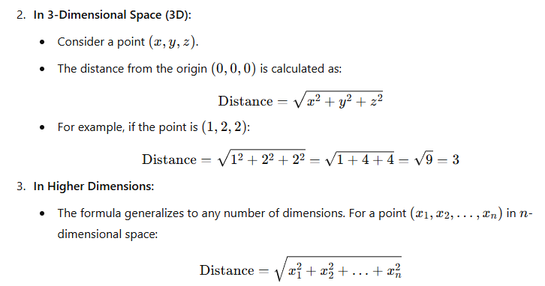

Slide 33
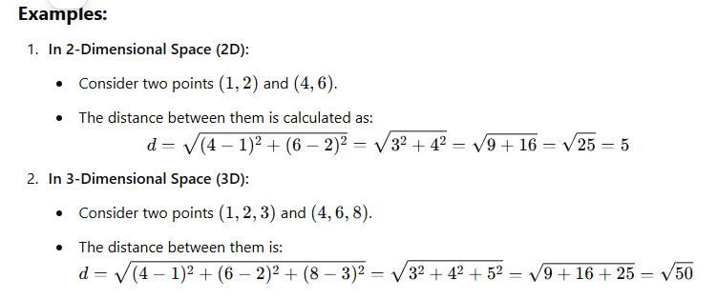
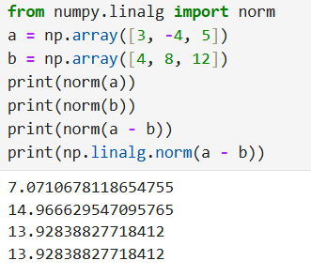


Slide 34
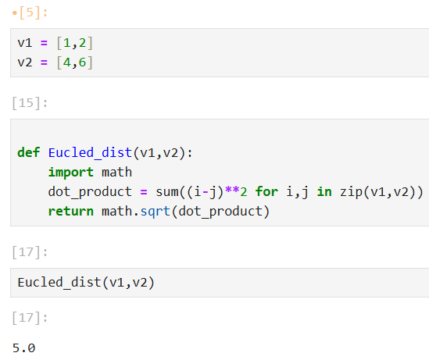

Slide 35
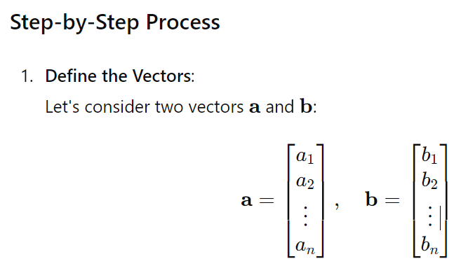
Angle between two vectors:
The angle between two vectors can be found using the dot product formula. Specifically, the dot product of two vectors is related to the cosine of the angle between them.

Slide 36
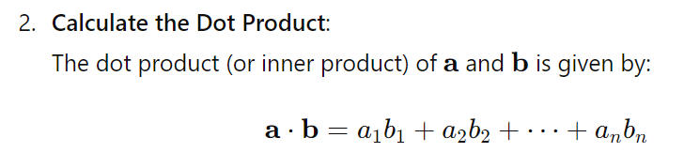
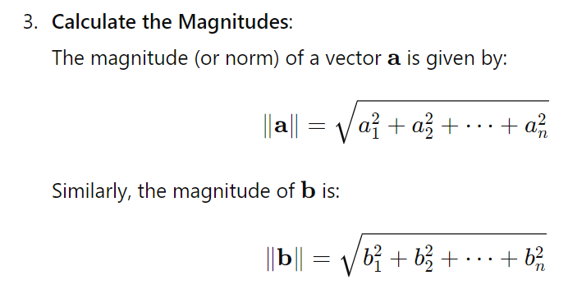

Slide 37
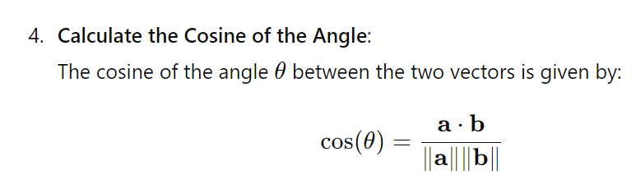
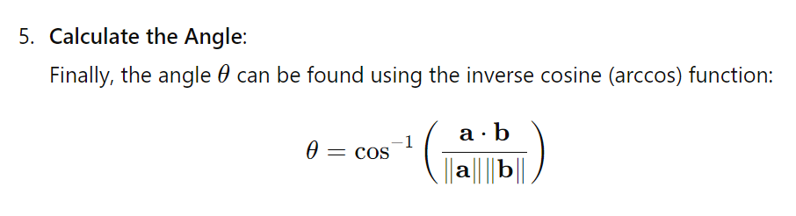
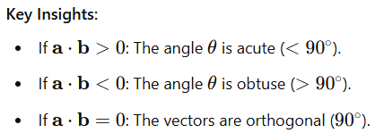

Slide 38
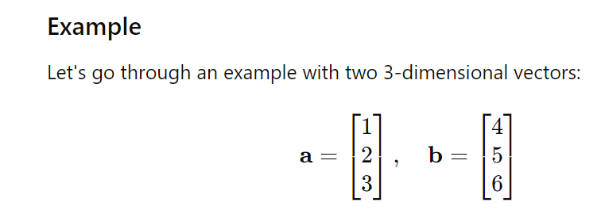
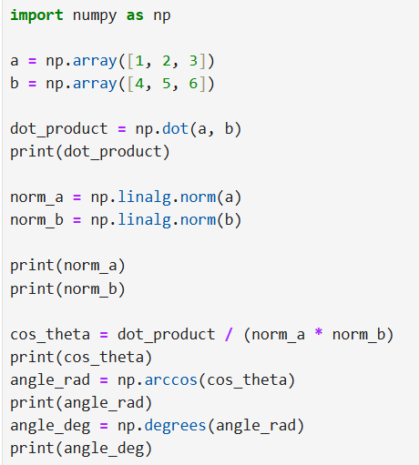

Slide 39
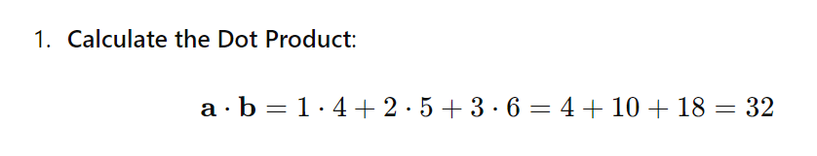
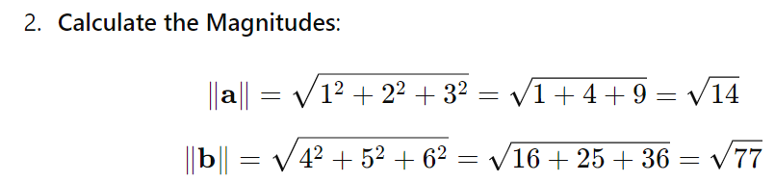
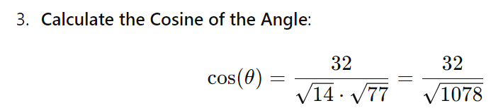
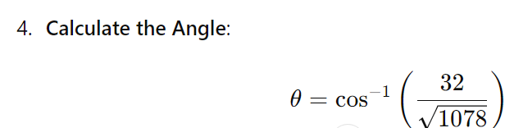

Slide 40
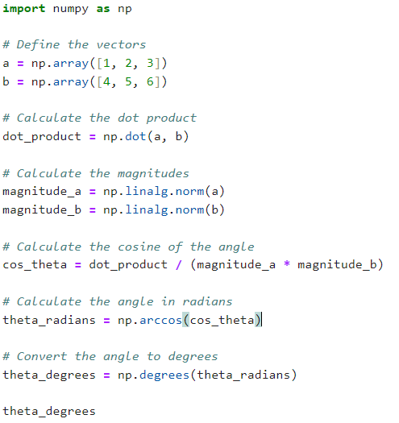

Slide 41

Cosine Similarity
Cosine similarity is a measure that calculates the cosine of the angle between two non-zero vectors in a multidimensional space.
This metric is often used to measure the similarity between documents or data points in high-dimensional spaces such as in text analysis, clustering, and other machine learning applications.
It is used to determine how similar two vectors are regardless of their magnitude.
Where A⋅B is the dot product of vectors A and B, and ∥A∥ and ∥B∥ are the magnitudes (norms) of the vectors.

Slide 42
Example:
Consider two text documents represented as term frequency vectors. These vectors represent the frequency of specific terms (words) in each document. Let's calculate the cosine similarity between these two vectors to determine how similar the documents are.
Document Vectors:
Let's assume the documents are vectorized as follows:
Document A: [1,3,0,2]
Document B: [0,2,1,3]
These vectors could represent the term frequencies of four specific words in two different documents.

Slide 43
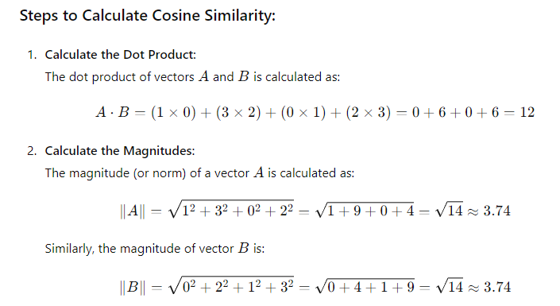

Slide 44
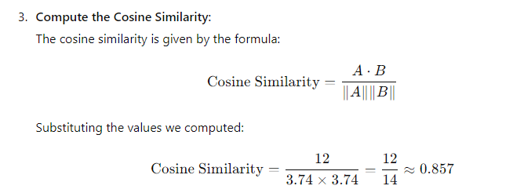
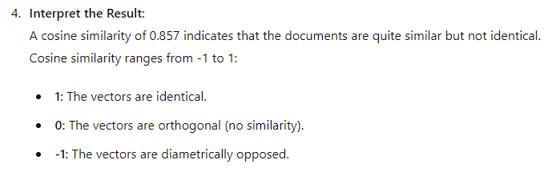

Slide 45
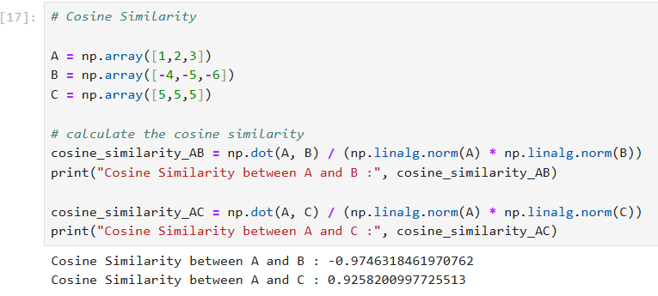

Slide 46


Slide 47

Projection of a Vector
Vector projection is a fundamental operation in linear algebra that has several applications in data science, particularly in understanding concepts like regression, principal component analysis (PCA).
The projection of vector a onto vector b is a vector that represents the shadow or footprint of a in the direction of b.

Slide 48

Steps to Compute the Projection

Slide 49


Slide 50


Slide 51
What is Normalization?
Normalization involves rescaling the data so that it lies within a specific range or has consistent magnitudes, often focusing on ensuring that features or data points are comparable in terms of distance metrics.
Why is Normalization Needed?
Ensure Fair Contribution of Features:
Without normalization, features with larger scales dominate distance computations in algorithms like k-NN, K-Means, and linear regression.
Example:
Feature 1: Age (1–100 years)
Feature 2: Salary (10,000–1,000,000)
Salary will disproportionately affect Euclidean distance unless normalized.

Slide 52

Normalization Techniques Using Distance

Slide 53

b) Z-Score Normalization (Standardization)

Slide 54

Eigenvalues and Eigenvectors
Eigenvalues and eigenvectors are fundamental concepts in linear algebra, and they play a crucial role in data science, as dimensionality reduction (e.g., Principal Component Analysis, or PCA), stability analysis.

Slide 55


Slide 56

X = (-b +- √(b^2 - 4ac ))/2a

Slide 57


Slide 58


Slide 59


Slide 60



Slide 61
Eigenvectors:
Vector that don't rotate after linear transformation but they can be scaled.
Eigenvalues:
The value by which vector get scaled
Eigenvalues and eigenvectors - Wikipedia

Slide 62


Slide 63


Slide 64

Example in HR Analytics: Employee Performance Evaluation

Slide 65

Step 1: Represent HR Data as a Matrix

Slide 66


Slide 67

Step 2: Why We MUST Scale (Very Important)
These metrics are on different units:
Skill → 0–100
Time → minutes
Satisfaction → 0–10
If we don’t scale → Task Time dominates

Slide 68


Step 3: Covariance Matrix (THIS is the square matrix)

Slide 69


Step 4: Eigenvectors & Eigenvalues (CORE CONCEPT)

Slide 70


Slide 71
Step 5: What Eigenvectors Mean (HR Interpretation)
Eigenvector | Meaning
PC1 | Overall performance (skill + satisfaction + collaboration)
PC2 | Efficiency vs skill tradeoff
PC3 | Team vs individual orientation
PC4 | Minor variation (noise)

Slide 72

Step 6: Eigenvalues = Importance
Meaning
PC1 explains 62% of performance variation
PC2 explains 23%
Others add little value

Slide 73

Step7️: Sort Components by Importance

Slide 74

Step 8: Projection

Slide 75

Step 9:Business Meaning (Very Important)

Slide 76
Steps of PCA:
In PCA, if two variables (or data points) are at the same distance from the origin, their significance or importance is determined by the amount of variance they capture in the data, not just their distance from the origin.
Step1: Standardization of Data(mean centering):
PCA requires the data to be standardized, meaning the mean of each feature is zero, and all features have unit variance.
This ensures that the PCA process treats each variable equally, regardless of its original scale.

Slide 77


Step 2: Covariance Matrix:
PCA calculates the covariance matrix of the data, which describes how much each feature varies from the mean with respect to other features.
It essentially captures the relationships between the different dimensions of your data.

Slide 78

Identify relationships between variables: PCA uses the covariance matrix to determine the directions in which the data varies the most. These directions (called principal components) correspond to the eigenvectors of the covariance matrix.
Maximize variance: The first principal component points in the direction of maximum variance. The eigenvalues of the covariance matrix indicate the amount of variance captured by each principal component.
Dimensionality reduction: By focusing on principal components that capture the most variance, PCA reduces the dataset's dimensions while retaining as much of the original variance as possible.

Slide 79
Step3:Eigenvectors and Eigenvalues:
The covariance matrix is decomposed into eigenvectors and eigenvalues.
Eigenvectors represent the principal components—the directions of maximum variance.
Eigenvalues represent the magnitude of variance captured by each principal component.
Step 4:Principal Components:
The principal components (PCs) are ranked by the eigenvalues, with the first principal component explaining the largest amount of variance in the data, followed by the second, and so on.
We typically retain only a few principal components, which capture most of the variability in the data, to reduce its dimensionality.
Step 5: Transformation:
The data is then transformed onto the new principal component axes. This gives a new, lower-dimensional representation of the data, which retains most of the important information.

Slide 80

Takeaways from the Output
How to Interpret These Results?
Standard Deviation (SD):
Higher SD means the component captures more variability.
PC1 has the highest SD (1.1077), meaning it explains the most variance.
Proportion of Variance:
PC1 explains 24.54% of the total variance.
PC2 explains 22.51%, and so on.
The variance decreases as we move to higher PCs.
Cumulative Variance:
PC1 + PC2 together explain 47.05% of variance.
PC1 to PC3 cover 67.83%.
PC1 to PC4 cover 85.75%, meaning these four components retain most of the information.
PC5 completes it to 100%, but adds only 14.25%, meaning it may not be as important.

Slide 81
Applications Data Science
Dimensionality Reduction: PCA (uses eigenvalues/eigenvectors).
Neural Networks: Matrix operations in forward/backpropagation.
NLP: Word embeddings, cosine similarity.
Clustering: Grouping similar data points together based on their vector representation.
Recommendation Systems: Comparing user preferences or item features to suggest similar items. Matrix factorization (SVD).

